Slide 1
SyriaTel – Customer Churn Assessment
Presented by:
Ali Rampurawala
Legendary Preds Inc.

Slide 2

Business Problem
Significant increase in customer churn rates
Impacting bottom line
Identify current customers likely to churn

Slide 3
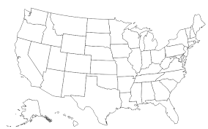



Key Questions
Total Charges?
Did the Customer Churn?
Location?
Total Usage?

Slide 4
Data
Historical Data (~3,000+ records)
Includes:
State
Minutes Usage
Charges
Churn (yes – 85% / No – 15%)

Slide 5
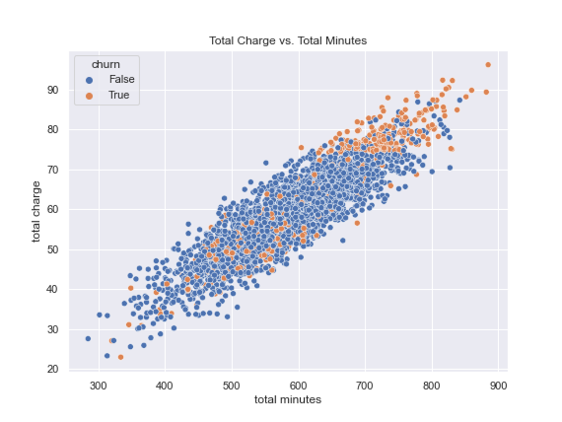
Initial Observations
Your “High-End” (best) Customers are Churning…

Slide 6
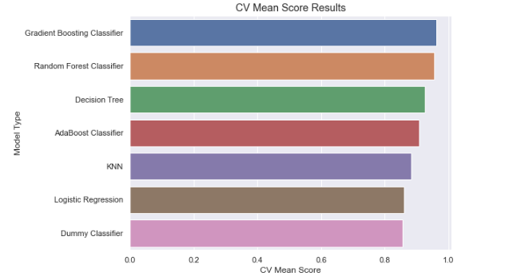
Modeling Process
Attempted 7 different model types
Selected top 2 types for further refining

Slide 7
Best Model - Gradient Boosting Classifier
After running hundreds of model iterations…
Final Accuracy Score: 97%
So…what does this mean?

Slide 8
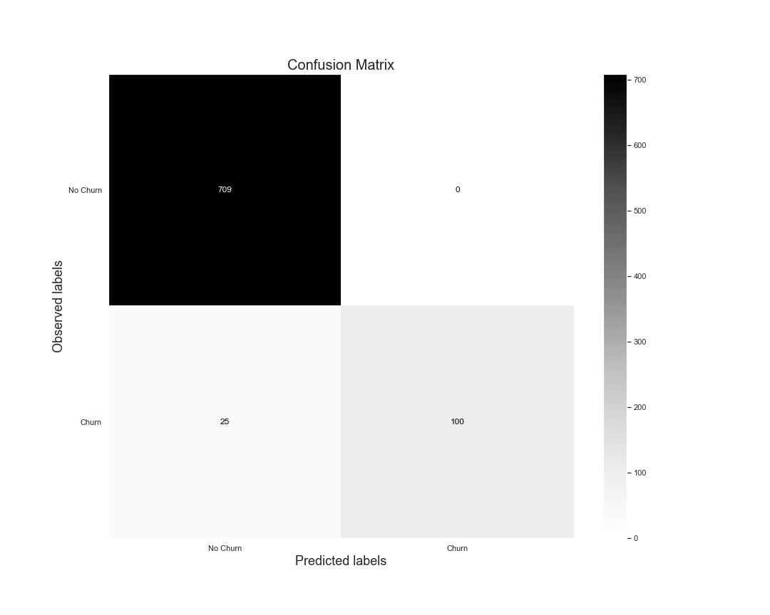
Model Results
Based on unseen data:
Recall = 80% (100/125)
Precision = 100% (100/100)

Slide 9
Recommendations
Focus on the 80% of customers that are flagged by the model
Provide these customers with one-time incentives or consider “unlimited” plans
Consider implementing customer surveys to help identify the other 20%

Slide 10
Closing thoughts
Things to explore
Consider further tuning the model to increase the “recall” score
Continue to add data each quarter and reconfigure model
Follow-through with recommendations

Slide 11
Thanks….
Any questions?

